Slide 1
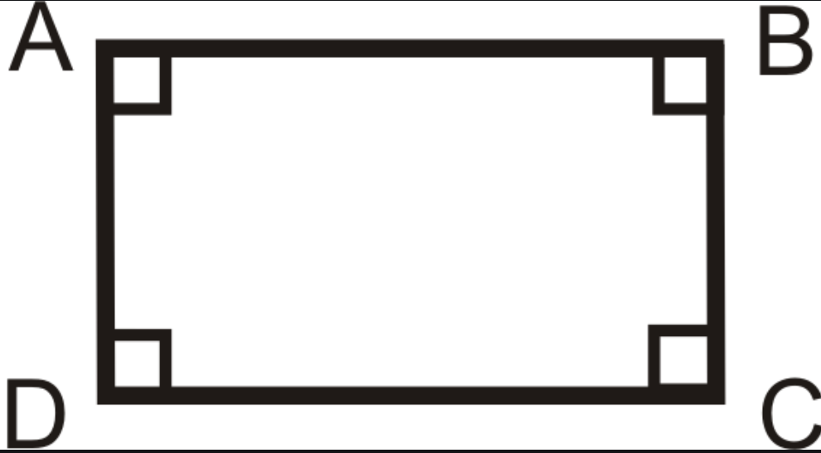
Show Rectangle Intersection
By: Bradley S. Ryall and Christopher Yonek
CSC164- Mr. Ng. (April 30th)

Slide 2
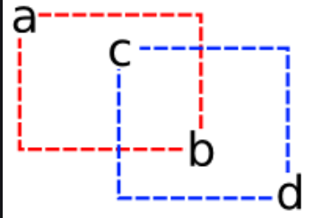
Purpose:
This program is made so that a user can enter exact size and locations of two rectangles before the program finally displays both rectangles, and shows their intersection.

Slide 3
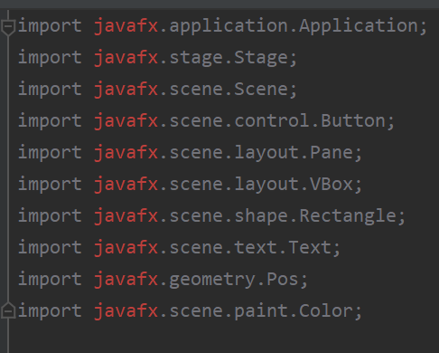
Imported from The JavaFX library

Slide 4
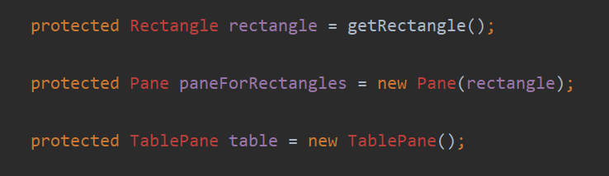
Private Elements

Slide 5
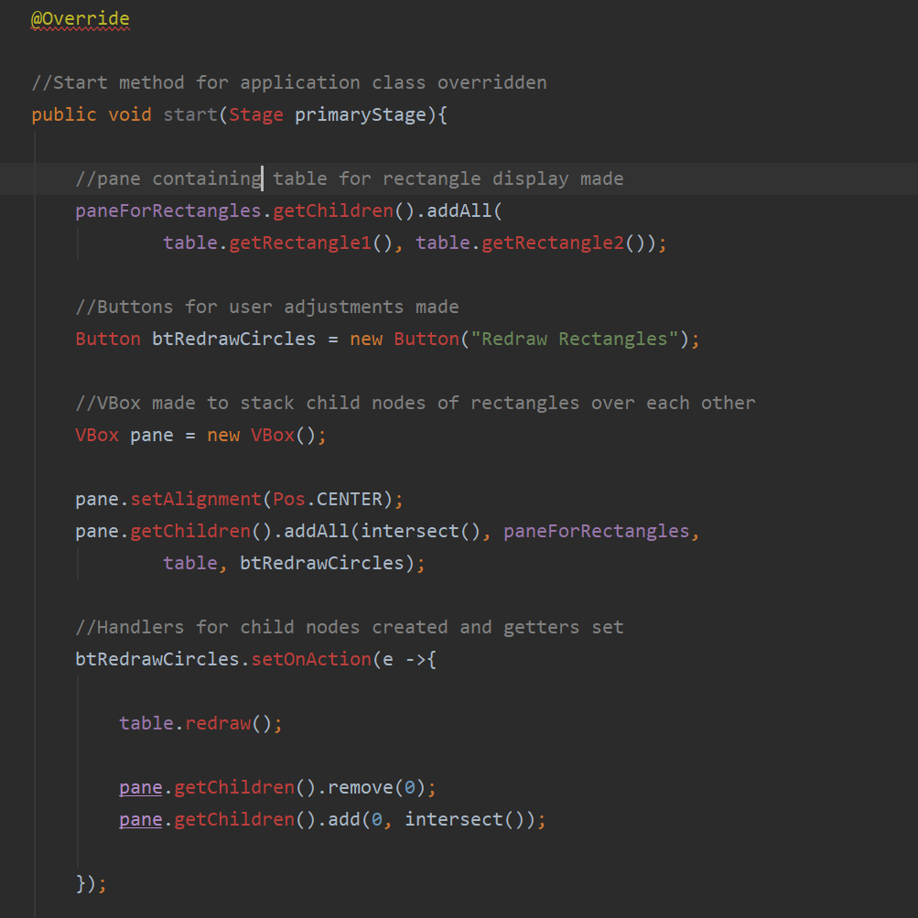
Method Overides

Slide 6
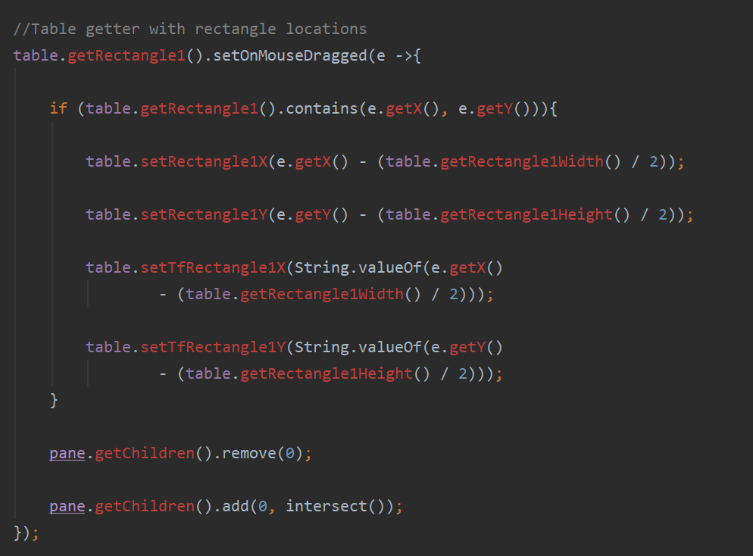
Methods to Get rectangle locations

Slide 7
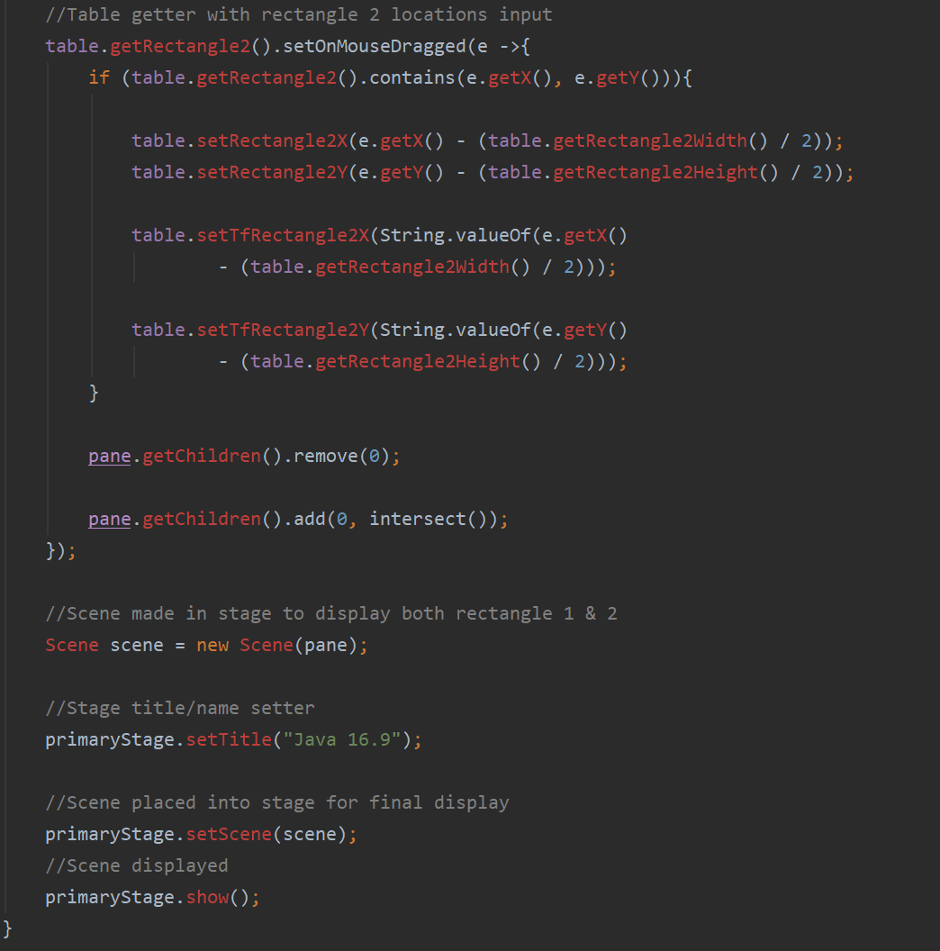
Rectangle Getter and Setter for X and Y Coordinates

Slide 8
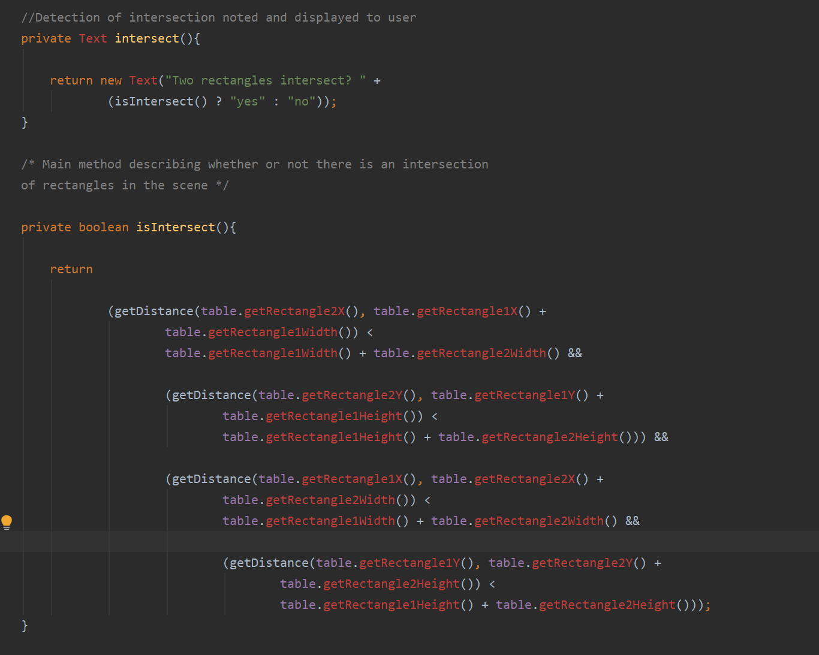
Method for detecting intersection of Points

Slide 9
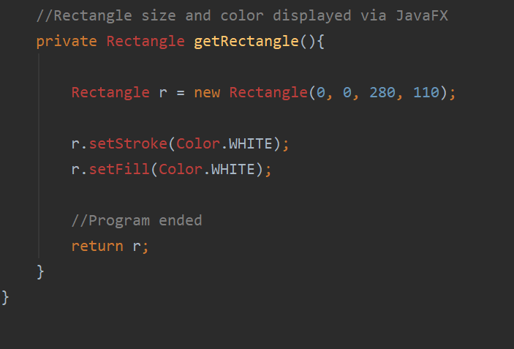
Rectangle Color and Dimensions

Slide 10
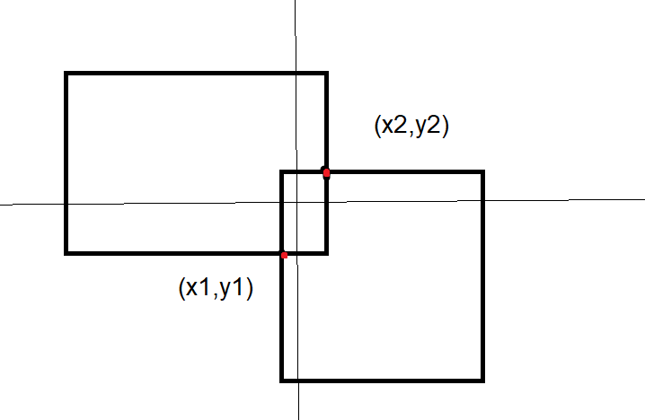
Outcome for Applet

Slide 11
What we learned…
*Using geometry to find points of intersection between rectangles.
*Learning how to link the JDK and SDK for javaFX.
*Researching the javaFX classes and methods.
*Accepting that some code needs to be completely removed and improved.

